Slide 1



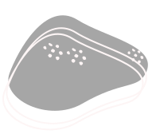

Animal
Computer
Interaction
The nearest branch and telephone number, please see our official website.

Slide 2
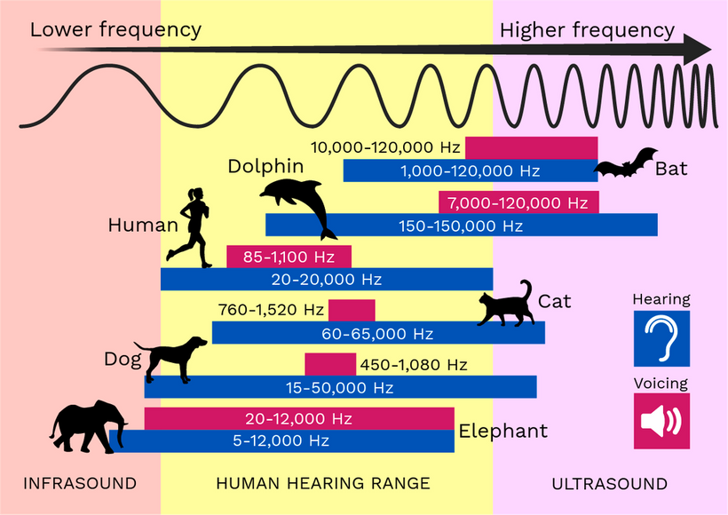
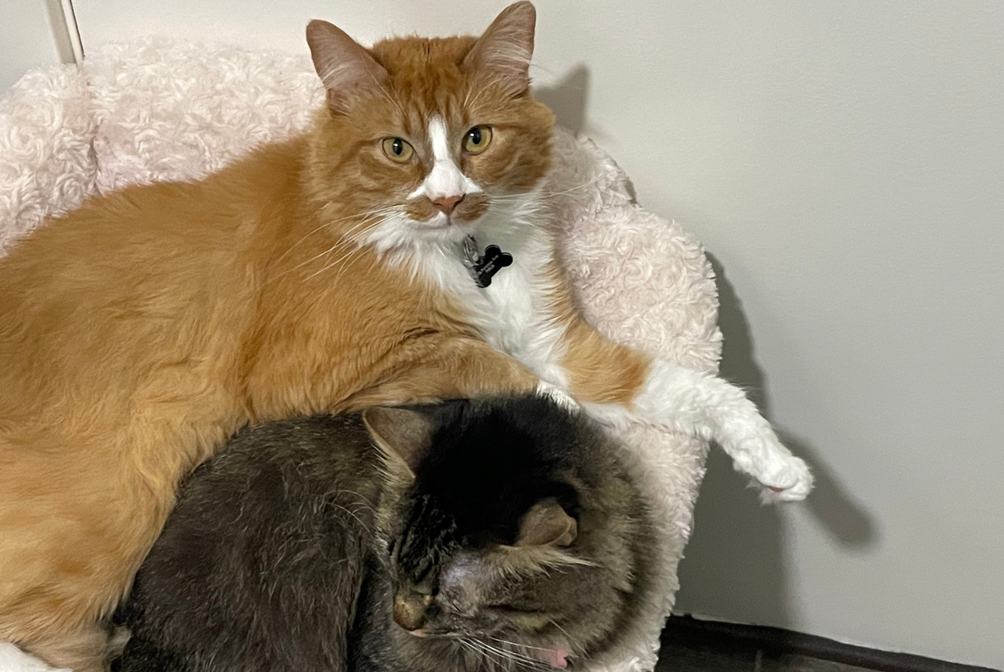
Envisioned System
Fully interactive ACI for cats
Would track the pupil distance of a cat
Reduce Volume after a certain distance
Output sounds:
Either birds chirping or fish swimming
Motivation
Came from my two cats

Slide 3
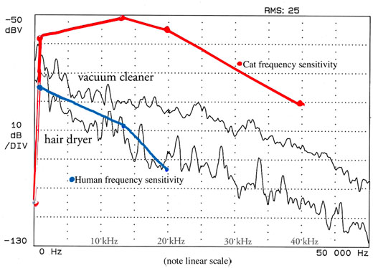
Problems/Successes
Problems
Using Pd to output reasonable frequencies
A lot of edge cases
having dogs
cats didn't like the frequency
Software - Problems
Reduction of volume within a certain distance
Successes
Was able to find a common factor noise - wind

Slide 4
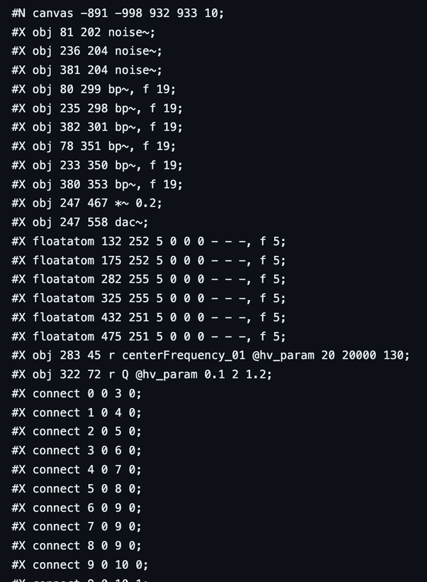
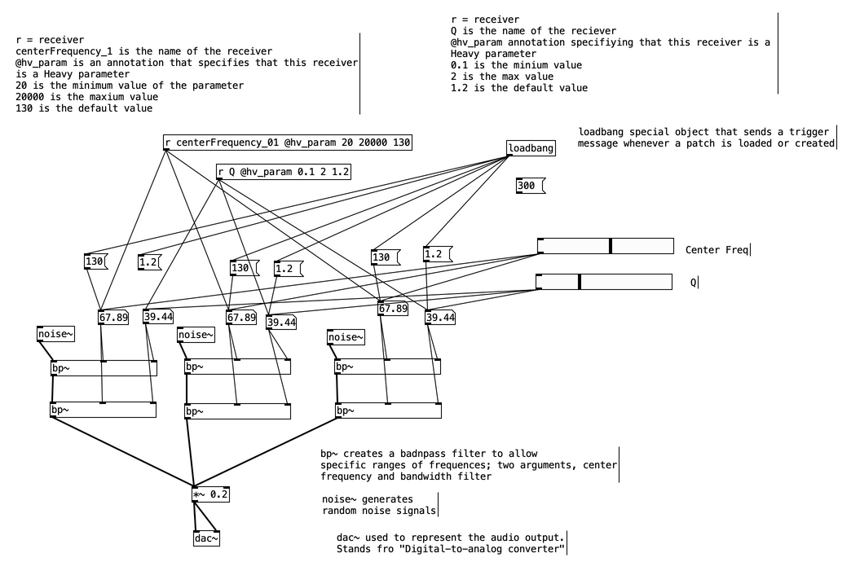

Implementation
Used WebPD for conversion
Used cvzone to capture motion detection
Used HTML, CSS to combine everything together

Slide 5
Relation to Literature
Referenced:
Responsive Environments by Myron W. Krueger
Was a research paper on humans reacting to a responsive environment
Choice of the sound and visual response system
Psychic Space creating an interactive visual experience

